Slide 1
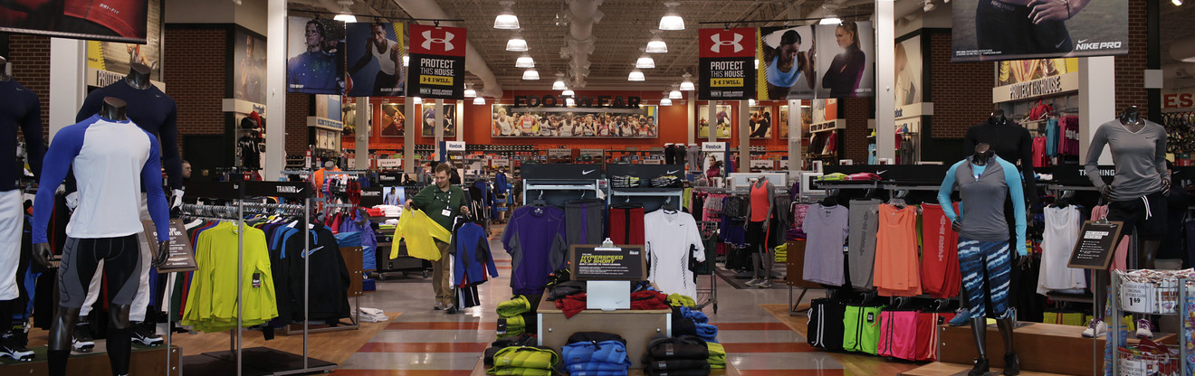

SPARTANS SPORTING GOODS
Submitted by: Ramya Mamidipaka Mukesh Ganesh Jaikumar Ambekar

Slide 2
Introduction
Sporting goods management system ties together the use point of sale (POS) coupled to a powerful inventory management engine in addition to a fully integrated, real-time accounting system which automatically makes postings as we complete day-to-day transactions.
Technology in maintaining sporting goods enables managers to keep everything organized. By having quick access to data on the database, improved response time for customer queries, optimized order tracking technique and equipment maintenance with which managers can enhance daily sports activities for improved performance.

Slide 3
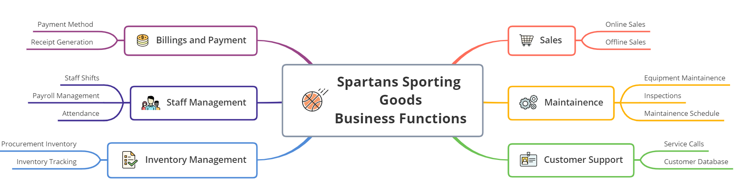
MIND MAP

Slide 4
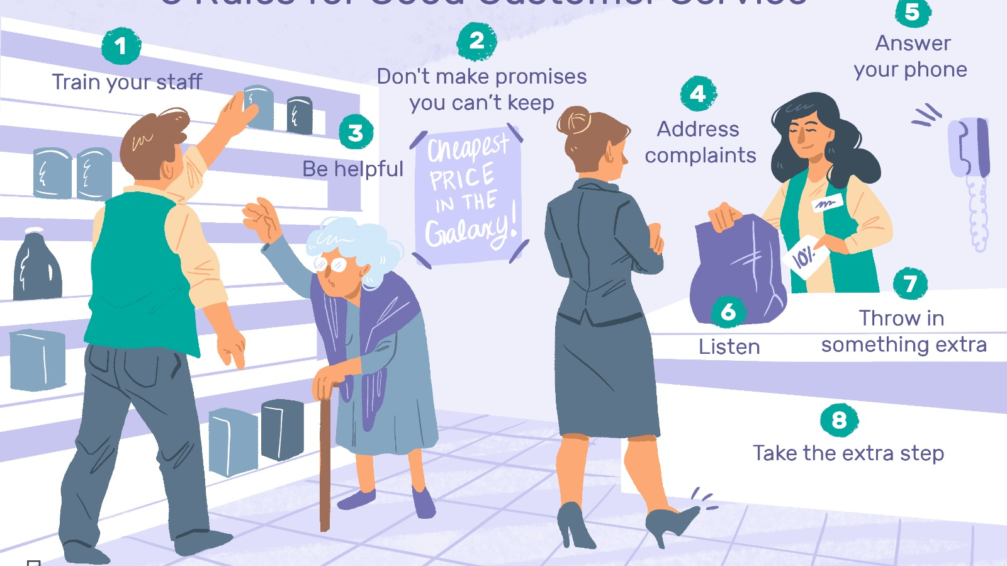
Business Scenario
Scenario
A Customer enters the store to buy a new pair of shoes and tennis racket to start with a new hobby. The Salesman guides him through the aisles and assists him with the correct fit and model for the shoes. The Customer navigates through the store and finally gets his fit and size for shoes. Satisfied with the shoes, Customer now proceeds towards the tennis racket rack and seeks the help of Salesman for a racket for beginners. Salesman has a dialog with the customer regarding requirements for the racket types or any particular parameters the customer is looking for. Then Salesman shows him the existing rackets in different price ranges and according to the parameters of the customer, which are best suitable for beginners. Customer chooses his pick and proceeds towards payment. Salesman informs the Inventory clerk about the customer's pick and the Inventory clerk replaces the purchased items in the rack. The Cashier hands over the goods and receipt to the Customer. The receipt contains the bill amount for the order along with the prices for each item and the tax applied. The Customer then selects his Feedback on the screen based on his experience at the store.

Slide 5
Business Scenario ANALYSIS
Type of Data | Entity | Data
Business Data | Order Receipt | Sale Summary Sale Item Details Sale Amount Store Detail
Inventory Data | Inventory Checklist | Items Purchased Sale Summary
Parsing Scenario to Identify key Information
Stakeholders: Customer, Salesman, Cashier
Products: Shoes, Tennis Racket
Infrastructure: Scanner, Computer, Card Reader, Receipt Printer

Slide 6
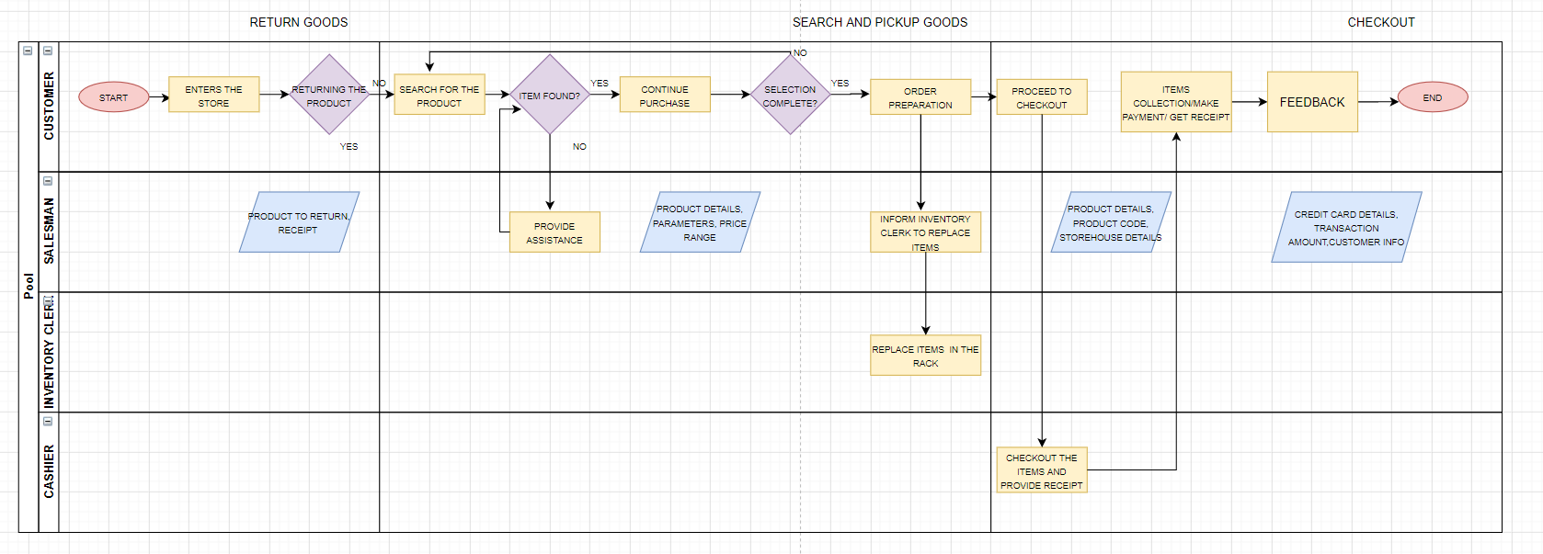
SWIM LANE DIAGRAM

Slide 7
ANALYTICAL MEASURES
LEAD MEASURES LAG MEASURES DESCRIPTIVE ANALYTCIS PREDICTIVE ANALYTICS

Slide 8
ANALYTICAL MEASURES
Lead Measures
Number of items in an order
Total orders in a day
Number of New customers daily
Inventory at the end of Day
Feedback score at the end of the end
Peak business hours for each day
New Customers signing up for the loyalty program Daily
Lag Measures
Profit for the Quarter/Year
Frequent Customers
Most sold items in each category of goods every quarter/year
Price Dynamics based on the Orders/ Market
ROI/ Revenue growth
Expenses/ Costs incurred in a Quarter/Year
Stock for the coming season
How well was the Loyalty program received by the customers
Goods returned the most

Slide 9

ANALYTICAL MEASURES – Descriptive ANALYSIS
Descriptive Analytics
This is a reflective analysis of user data and is meant to provide insight into historical patterns of behaviors and performance in online learning environments. Descriptive analytics is leveraged when a business needs to understand the overall performance of the company at an aggregate level and describe the various aspects.
Trends of revenue in the total fiscal year
Comparing sales for the past years
Determining the most common payment type(cash/debit/credit)
Most bought goods for the customers for each region
Validate if a promotional campaign was successful or not
Customer Clusters for the promotions
Sales across various branches
Goods which were out of stock the most
Reviews

Slide 10

ANALYTICAL MEASURES – Predictive ANALYSIS
Predictive Analytics
The subsequent step in data reduction is predictive analytics. Analyzing past data patterns and trends can accurately inform a business about what could happen in the future. This helps in setting realistic goals for the business, effective planning and restraining expectations. Predictive analytics is used by businesses to study the data and ogle into the crystal ball to find answers to the question “What could happen in the future based on previous trends and patterns?”. This is mainly undertaken to gather data on customers and predict next actions based on historical behavior.
Improving operations to better manage inventory and other resources
To set prices based on things like seasonality
Launch promotions that better targeted your customers
Introducing new goods into the chain based on inputs from the market

Slide 11
DATA MODELING
OLTP SCHEMA ODS SCHEMA OLAP SCHEMA

Slide 12
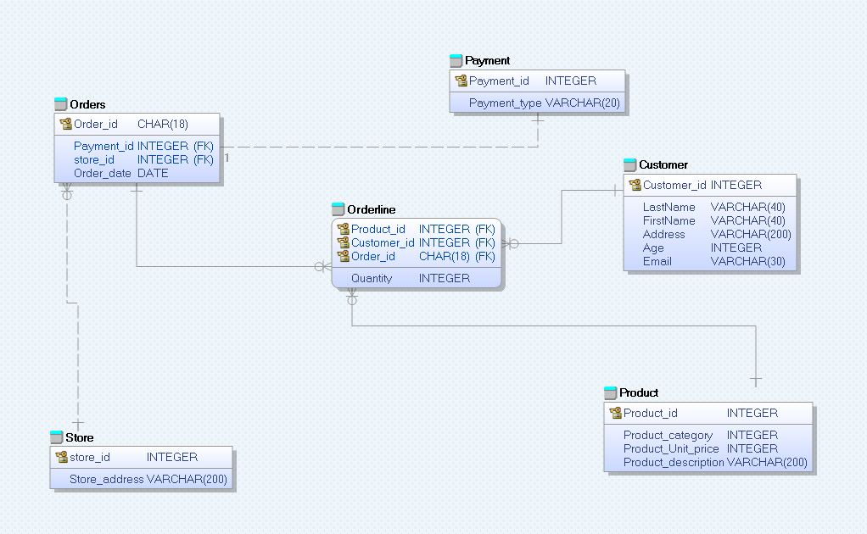
OLTP SCHEMA
The OLTP schema is designed to have 6 tables
Orders
Payment
Employee
Store
Customer
Product

Slide 13
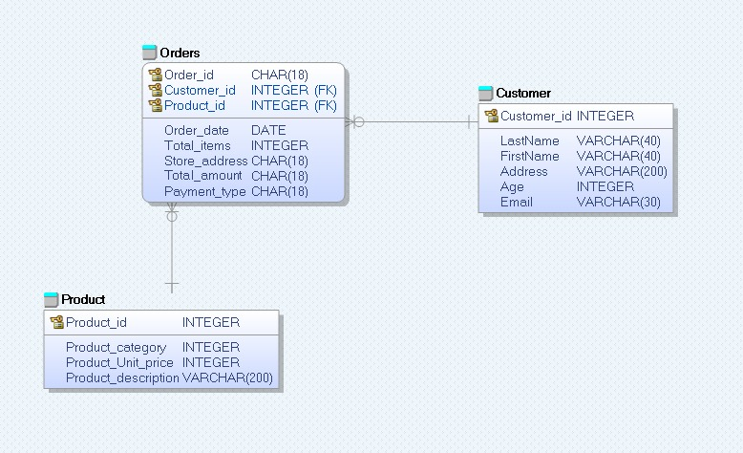
ODS SCHEMA
It is an interim area for a data warehouse sitting between the data sources and the data warehouse. An ODS deals exclusively with current operational data and basic status-level reporting, because an ODS continuously overwrites data. Here we merged Store details, payment details into order table.

Slide 14
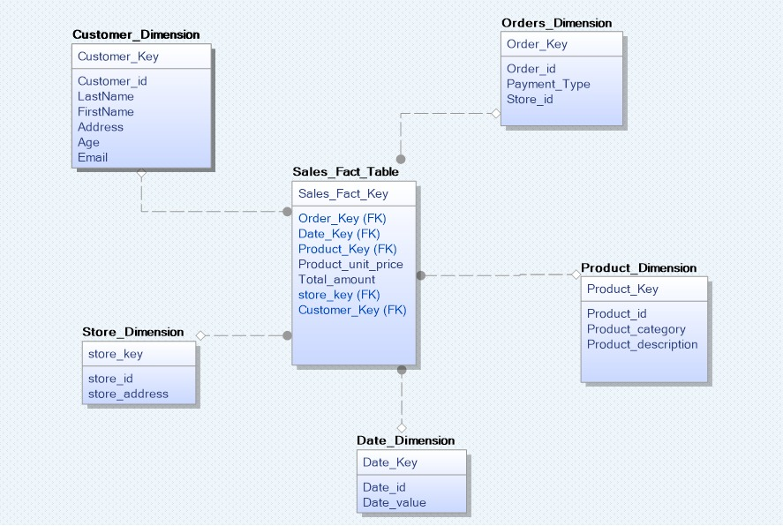
OLAP SCHEMA
There are five Dimension tables and one fact table.
The Dimension tables are:
Date
Customer
Product
Store
Orders
Fact table
Sales

Slide 15
ETL IMPLEMENTATION
TOOLS: PENTAHO MySQL Generatedata.com

Slide 16





ETL IMPLEMENTATION
Data Sources used for implementation:
MySQL Database
Json
CSV
Excel
Data Sets: Data are manually generated from generatedata.com
Website: Generatedata.com
Procedure Followed
Loaded the data from multiple sources mentioned above into the spartans_gamestore database
Created a staging denormalized schema from the OLTP database
Created dimension table from the database with Surrogate keys
Loaded the dimension tables into spartans_gamestore_dw database
And then loaded the Fact table into the DW database

Slide 17
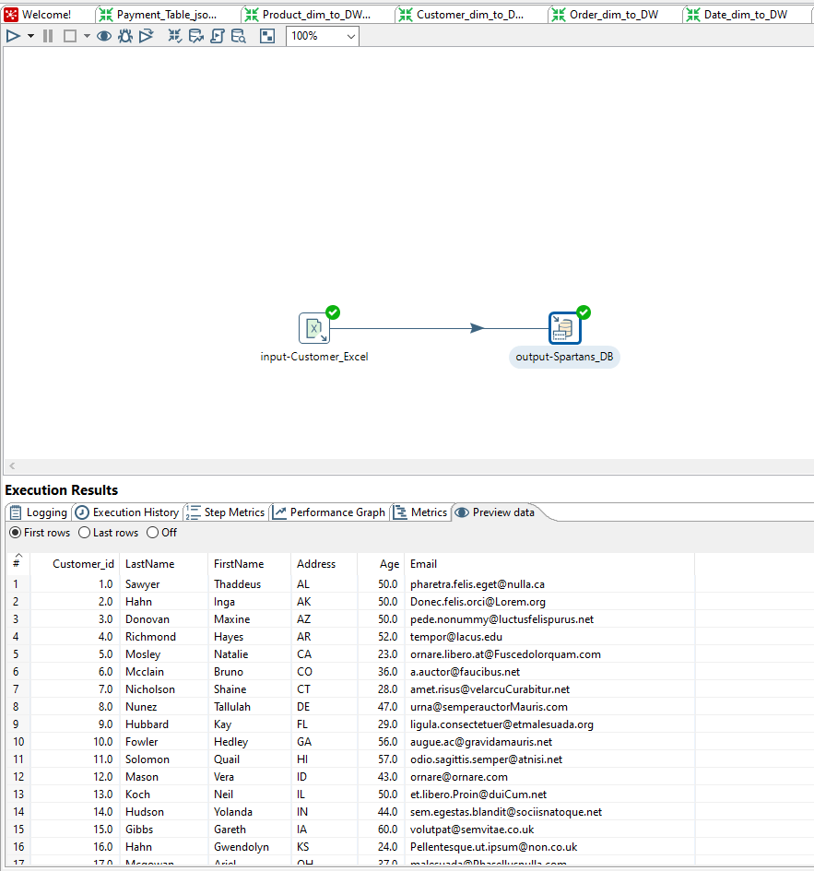
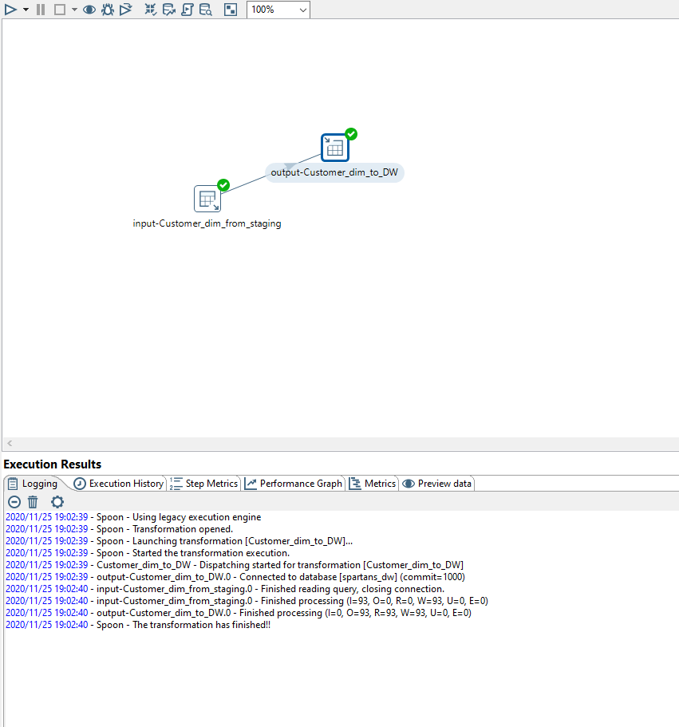

Slide 18
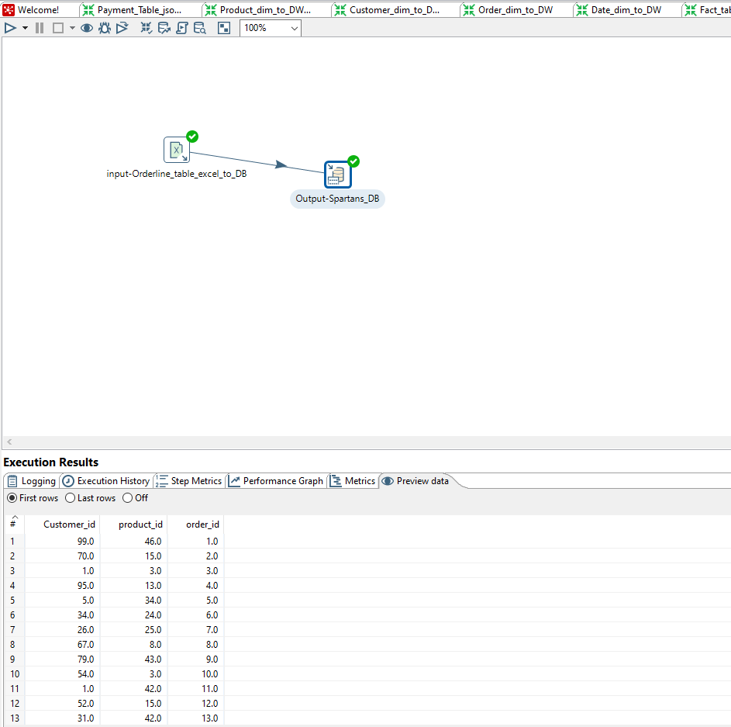
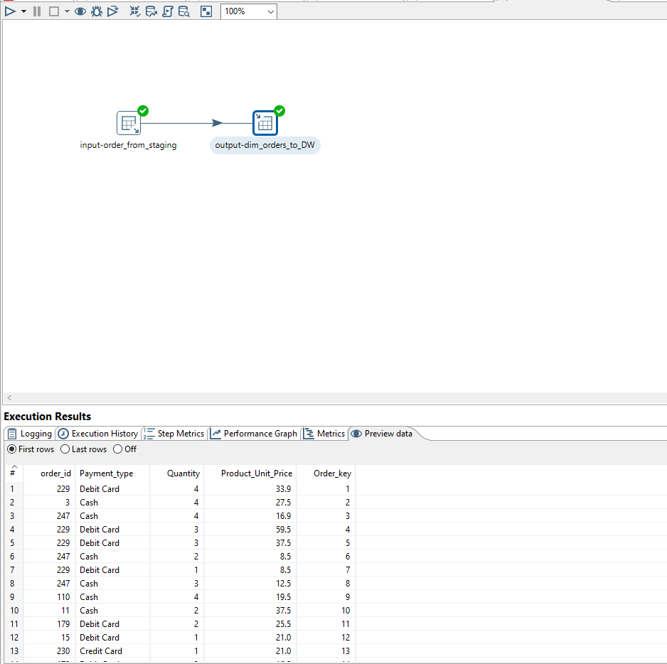

Slide 19
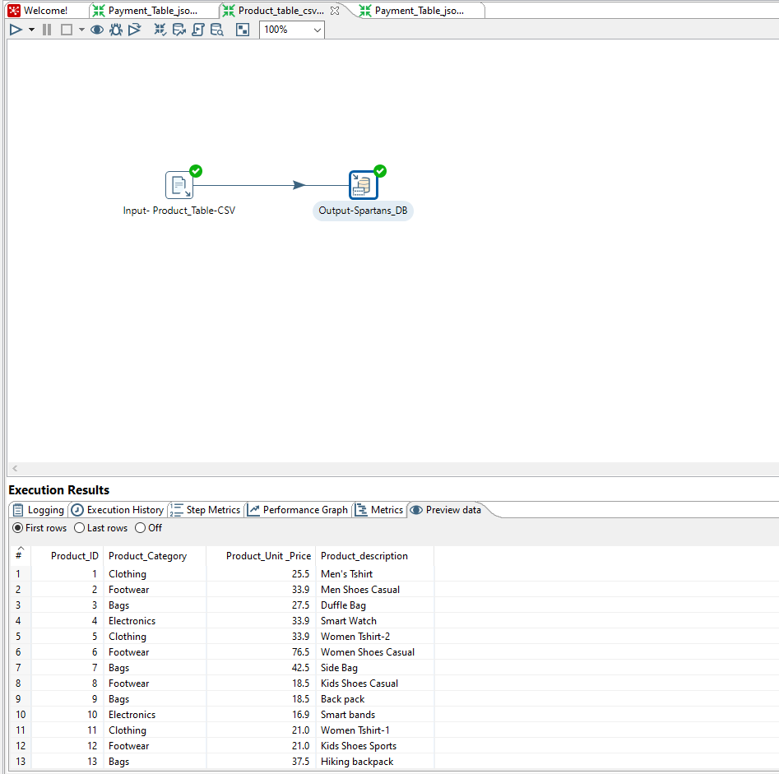
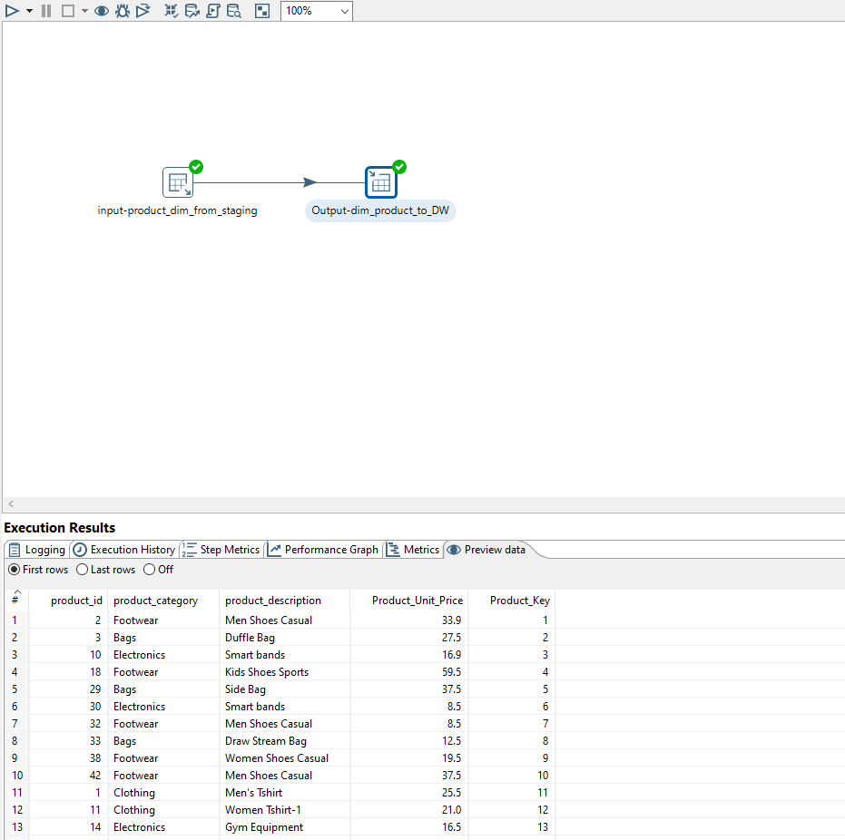

Slide 20
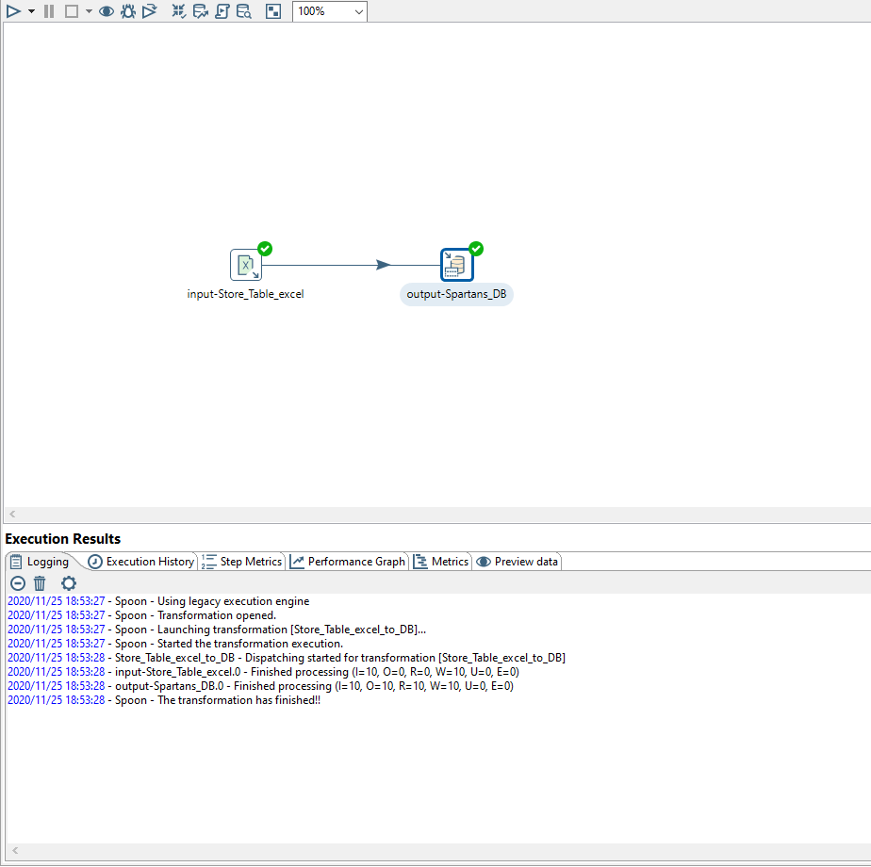
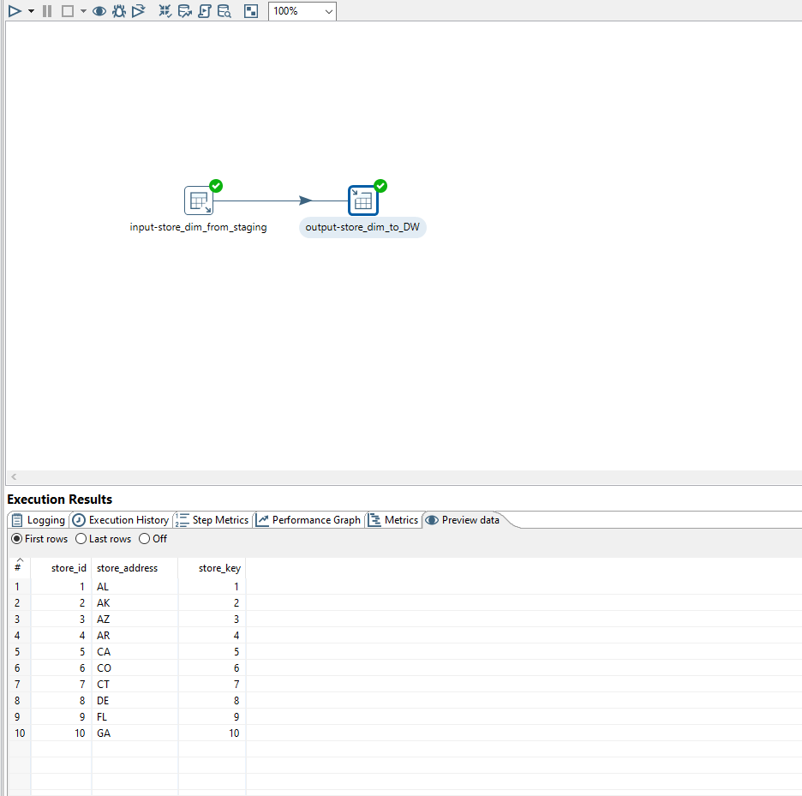

Slide 21
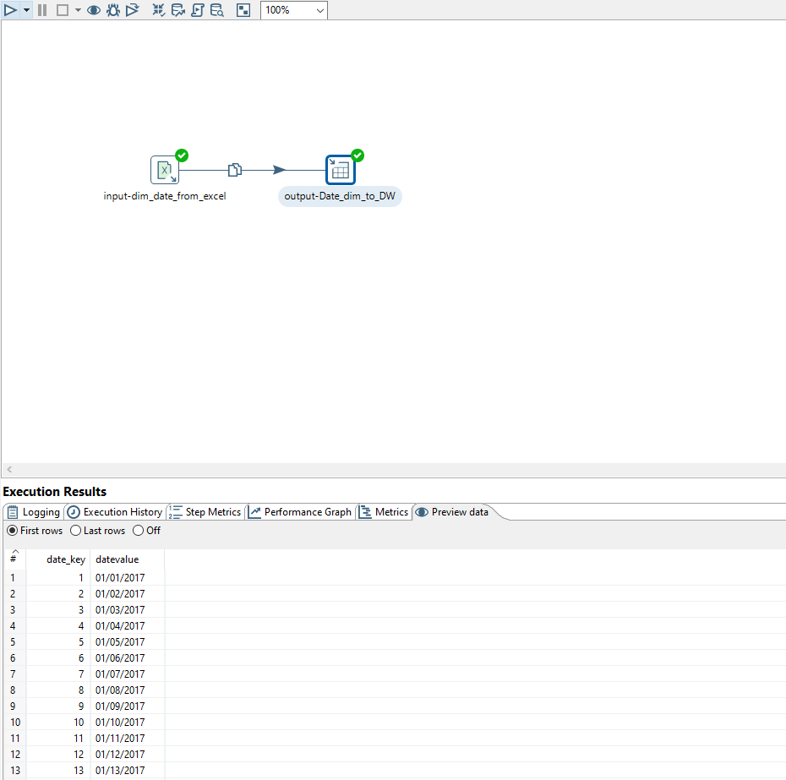
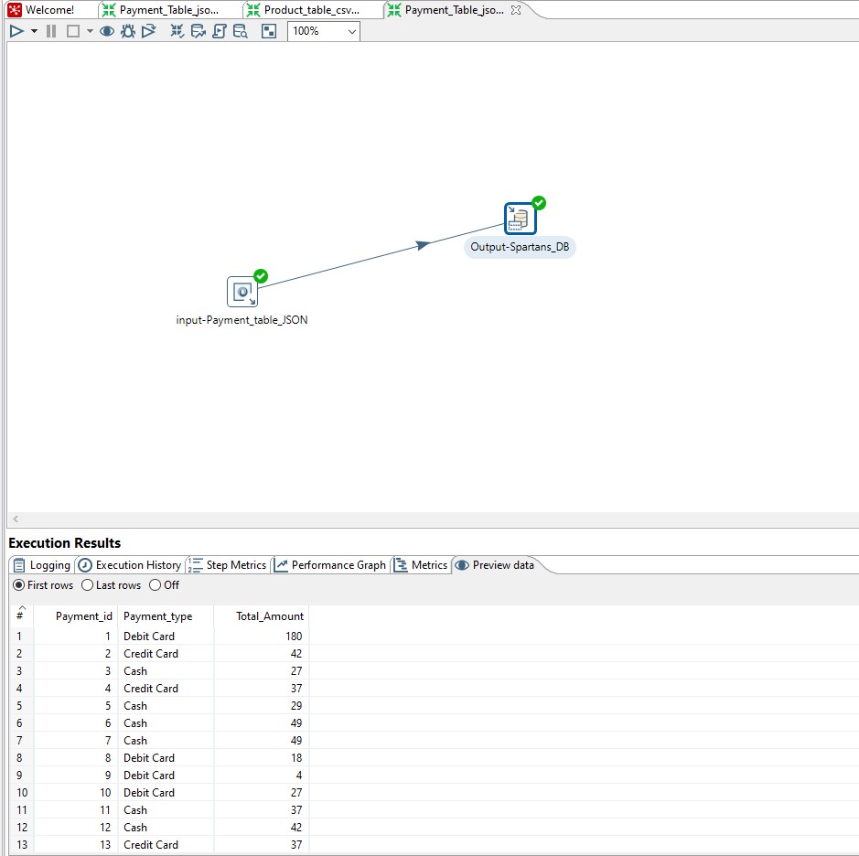

Slide 22
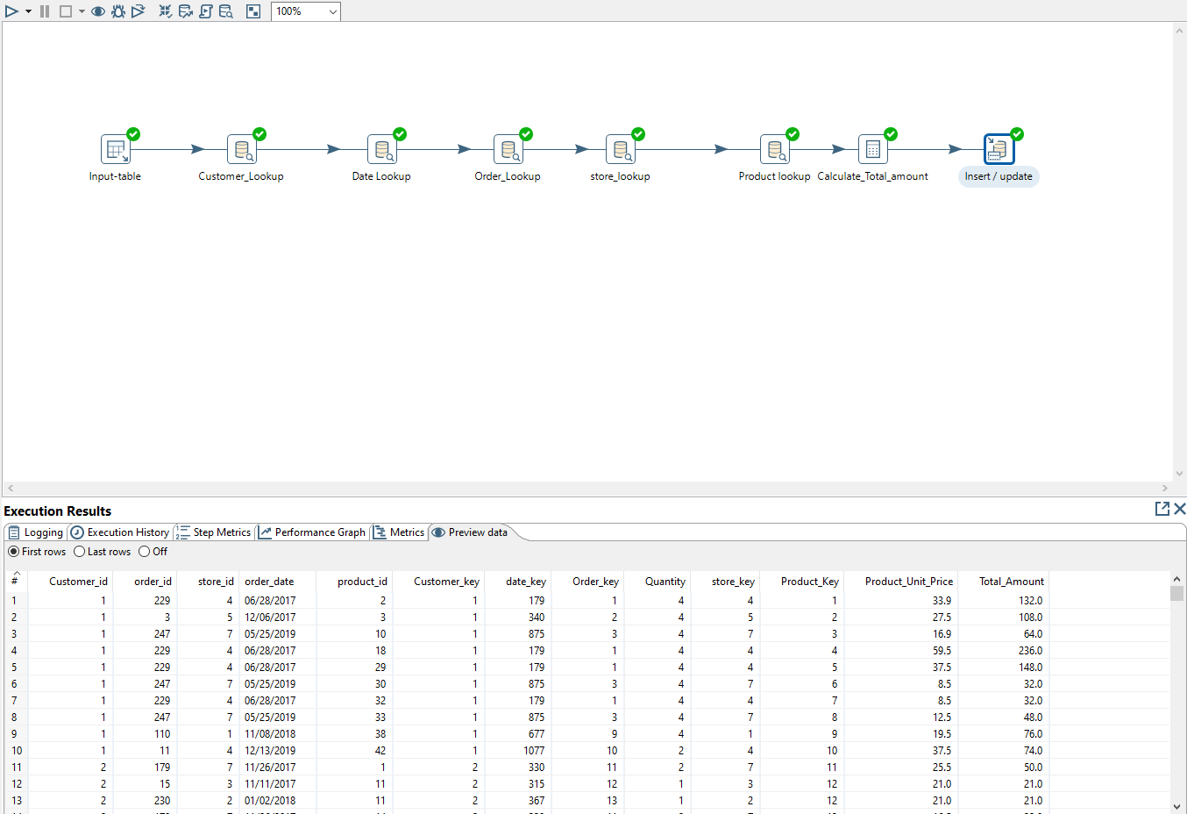
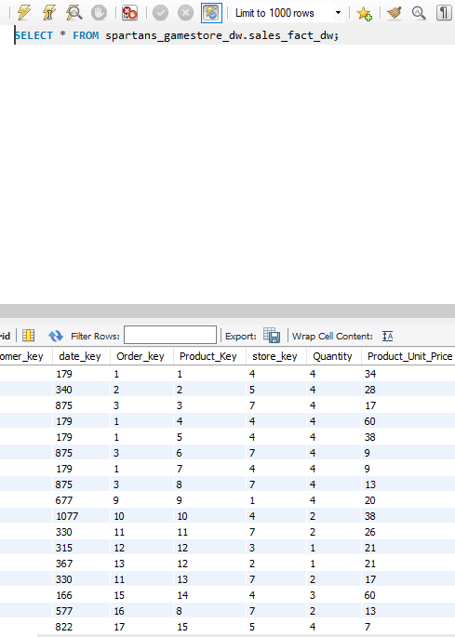

Slide 23
TABLEAU IMPLEMENTATION
The Tableau file twbx has lead, lag, prescriptive and descriptive measures in a story. The main metrics which are highly insightful and impact the business decisions are taken and included in dashboards.
Dashboard 1 - Lag Measures:
Revenue per store/per year
Revenue each Quarter
Average Orders per month
Revenue each month
Dashboard 3 - Descriptive Analysis:
Sales Vs Category
Age Vs category
Payment Type Analysis
State wise distribution
Dashboard 2 - Lead Measures:
Orders in week
Revenue per week
Product most sold in each weekday
Dashboard 4 – Predictive Analysis:
Revenue Forecast
Demand Forecast

Slide 24
CONCLUSION
In summary, BI makes it possible to combine data from multiple sources, analyze the information into a digested format, and then disseminate the information to relevant stakeholders. This allows companies to see the big picture and make smart business decisions. By analyzing all these metrics and reports business can make critical decisions about the inventory, which stores are lucrative, which products need improvement, product unit price optimization.

